Slide 1
Solving the Maze problem with ILP
Angelo Andreussi, Alex Della Schiava, Claudia Maußner

Slide 2
The maze
All three implementations use the same maze:
 |  | X=1 | X=2 | X=3 | X=4 | X=5
Y=1 |  | S
Y=2
Y=3
Y=4
Y=5 |  |  | G

Slide 3
ILASP
Actually, ilasp version 3

Slide 4

Brief overview on ASP
ASP model is (roughly speaking) a set of rules that represent logics of a problem. The solver tries to find all interpretations (atoms wich are true) that satisfies rules, namely the Answer sets.
An example for the maze problem: write set of rules that specify legal moves on the grid in a logical manner and find out all answer sets: different set of moves (paths) from start to goal position.
Different types of rules in an ASP encoding:
Normal rule :
h :- b1, . . . , bn | where h1 is an atom and b1 . . . bn are literals…semantic similar to prolog.
Hard constraint :
:- b1, . . . , bn | if b1 . . . bn are satisfied by an interpretation, then it cannot be an answer set.
Choice rule :
l{h1; . . . ; hm}u :- b1, . . . , bn | l, u integers. If the body is satisfied then between l and u of the atoms h1...hm are satisfied

Slide 5
ILASP
The Inductive learning tool used in ASP is Ilasp.
It enables learning programs containing normal rules, choice rules and hard constraints, specifying (as always) background knowledge, search space and positive + negative examples.
Here it has been used for the maze problem, specifically to learn some normal rules that compose the ASP model wich solves the problem of path finding.

Slide 6

Learning to move on adjacent cells
Goal: Learn the move on adjacent cells, not considering for now the obstacles. (namely, Predicate next/2).
Somethig like : next((X1,Y1), (X2,Y2)) holds if coordinates are near.
Background Knowledge:
«succ» predicate, = holds for consecutive numbers.
«cell» predicate, = hold for coordinates on the grid.
Positive examples: shows that next holds for near cells on the grid /Negative examples: shows different contexts where next doesn’t hold: when 2 cells are distant, or when you exit from the grid, when cells are in the same diagonal.
mode bias: predicates «cell», «succ», and «next» on the head of the rules.

Slide 7
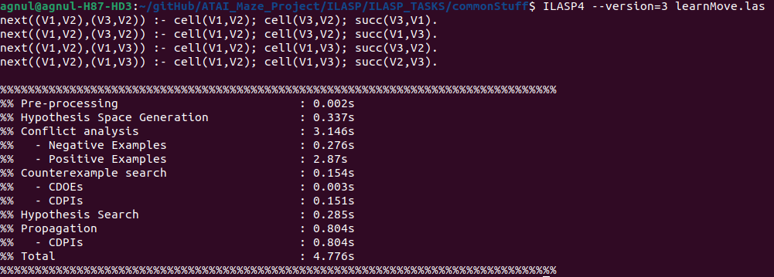
Output of ILASP task
(Vx, Vy) are coordinates on the grid

Slide 8
Learning to move on adjacent cells – considering obstacles
Goal: using what learned previosuly, learn to move into cells without obstacles (Predicate nextLegit/2).
Something like : nextLegit((X1,Y1), (X2,Y2)) holds if coordinates are near and not contain obstacles.
Background Knowledge:
«succ» and «cell» predicates, as previously
«obstacle» predicate: holds when obs. is on the coordinate.
«next predicate» (learned prev).
Positive examples: shows that nextLegit is true in cells without obstacles /Negative examples: shows that nextLegit is not true in cells with obstacles
mode bias: predicates «next», «obstacle», and «nextLegit» on the head of the rules.

Slide 9
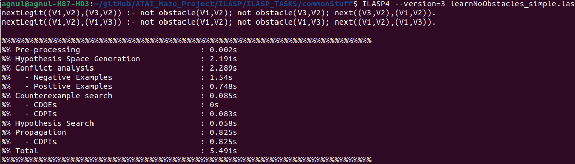
Output of ILASP task
(Vx, Vy) are coordinates on the grid

Slide 10
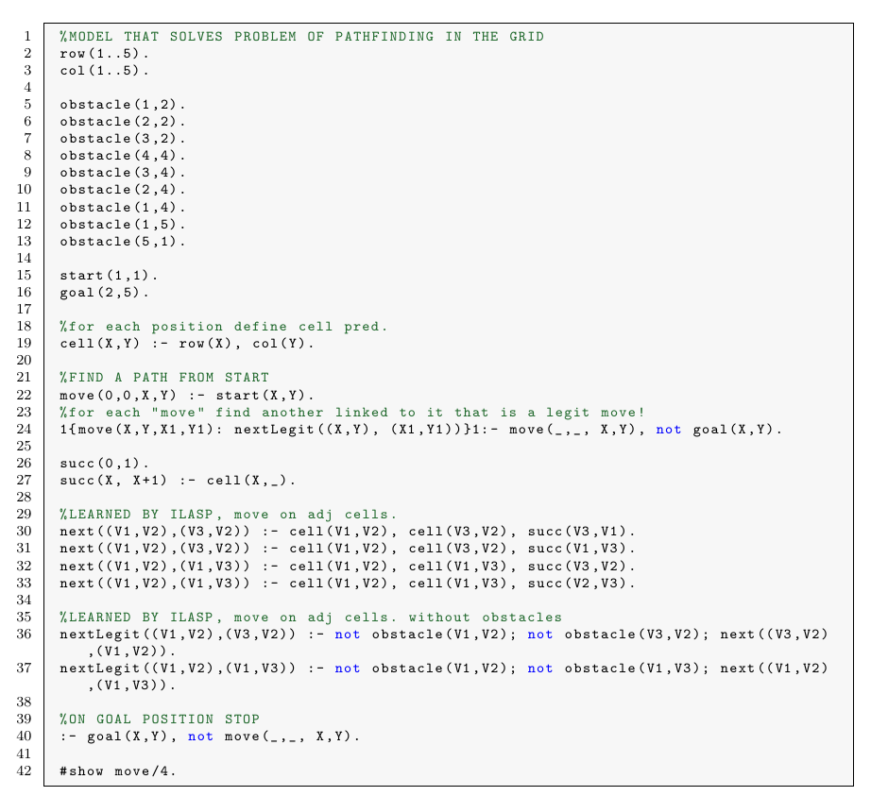
Combining what learned in an ASP model

Slide 11
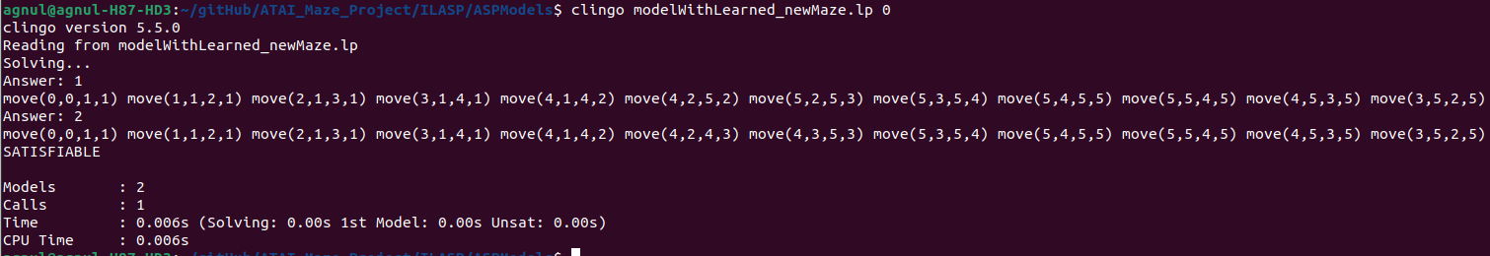
Execution of the solver on the model
paths found on our grid

Slide 12
Analysis on scalability of the tool
Work done in ILASP shows clearly a fact: time complexity doesn’t scale well with respect to search space dimension.
Trying to do the 2 previous tasks both on the same script was not feasible: the search space was too big, but actually the second task «just» got 1 more predicate (obstacle)!
ILASP got an option to show the search space of a task, by using the linux «wc» command it is possible to extract its dimension and later do an analysys of the relation time – search space dimension

Slide 13
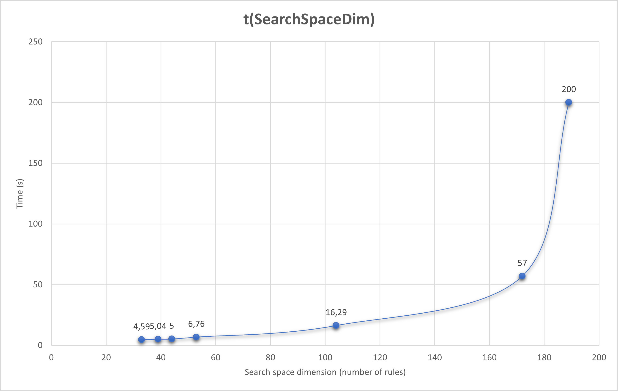
Performance analysis results
Evident exp. Trend ! This implies that it’s a good practice split a task in other tasks

Slide 14
Performance comparison
Task | Hyper | Metagol | ILASP
adjacent | 175,884 s
move | 0,063 s
reach | 1,577 s
move & reach | 16,585 s
Mean values from 10 runs

